Slide 1
Biases in ecological and paleoecological data
Teaching Golems about the real world
Dr. Gregor Mathes

Slide 2
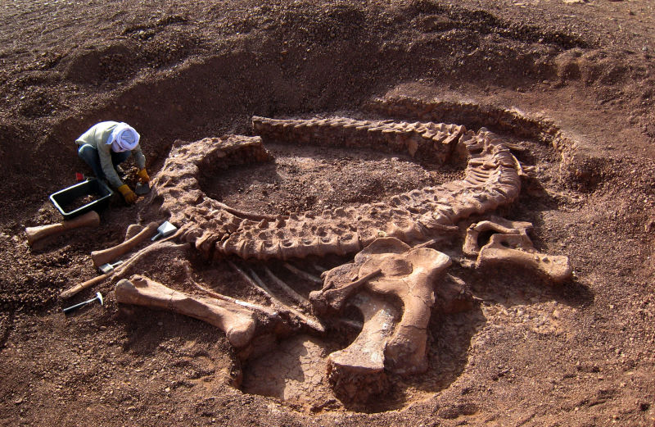
Classical paleontology

Slide 3
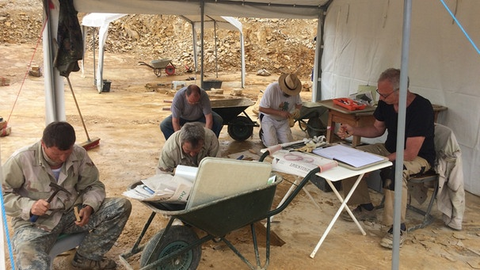
Classical paleontology
Excavations in the Wattendorf quarry (near Bamberg), Image credit: BR-Studio Franken/ Heiner Gremer

Slide 4

Fossil databases

Slide 5
Extinctions
20 species extinctions
potentially through
climate change
864 Holocene
species extinctions
844 species extinctions
caused by other drivers
Cahill et al., 2013

Slide 6
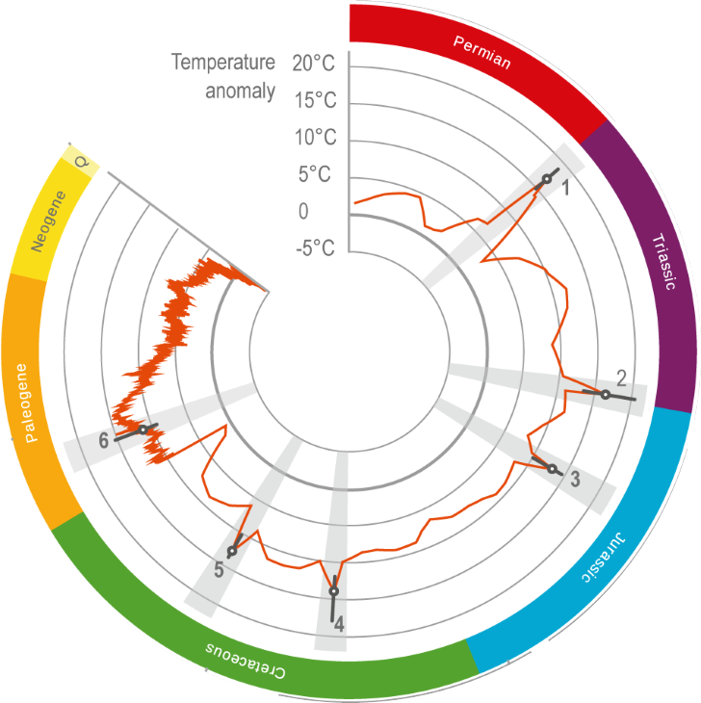
Paleontology as a baseline

Slide 7
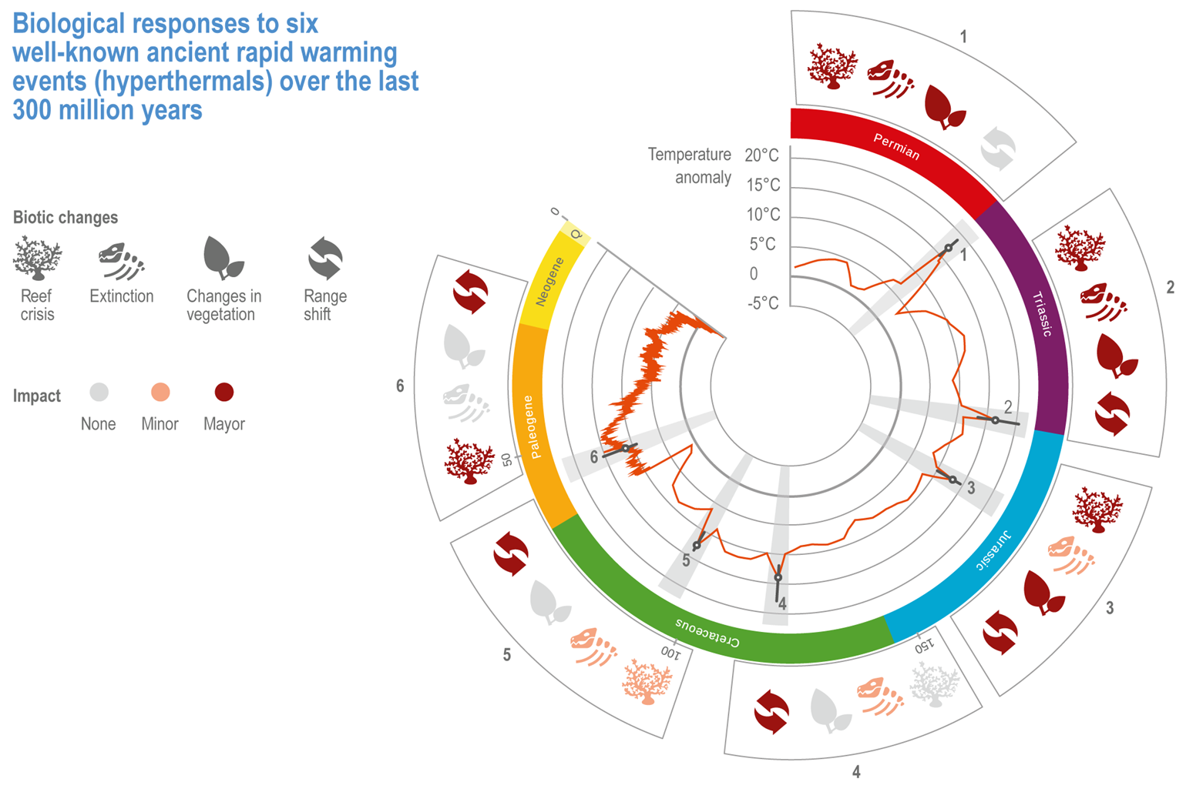
Paleontology as a baseline

Slide 8
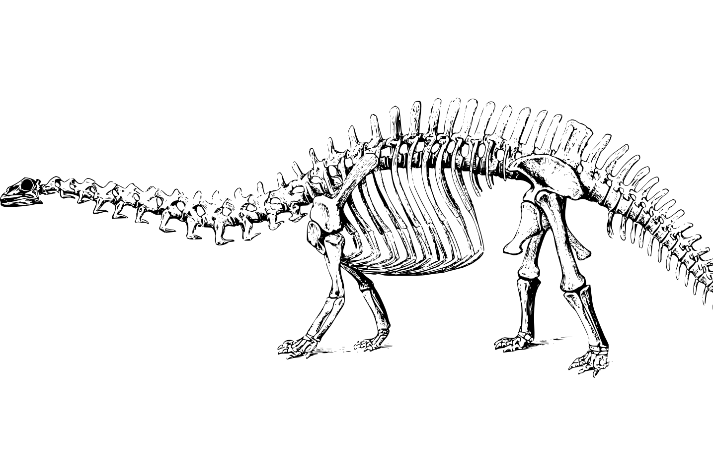
Paleontological biases
Mind the gap

Slide 9
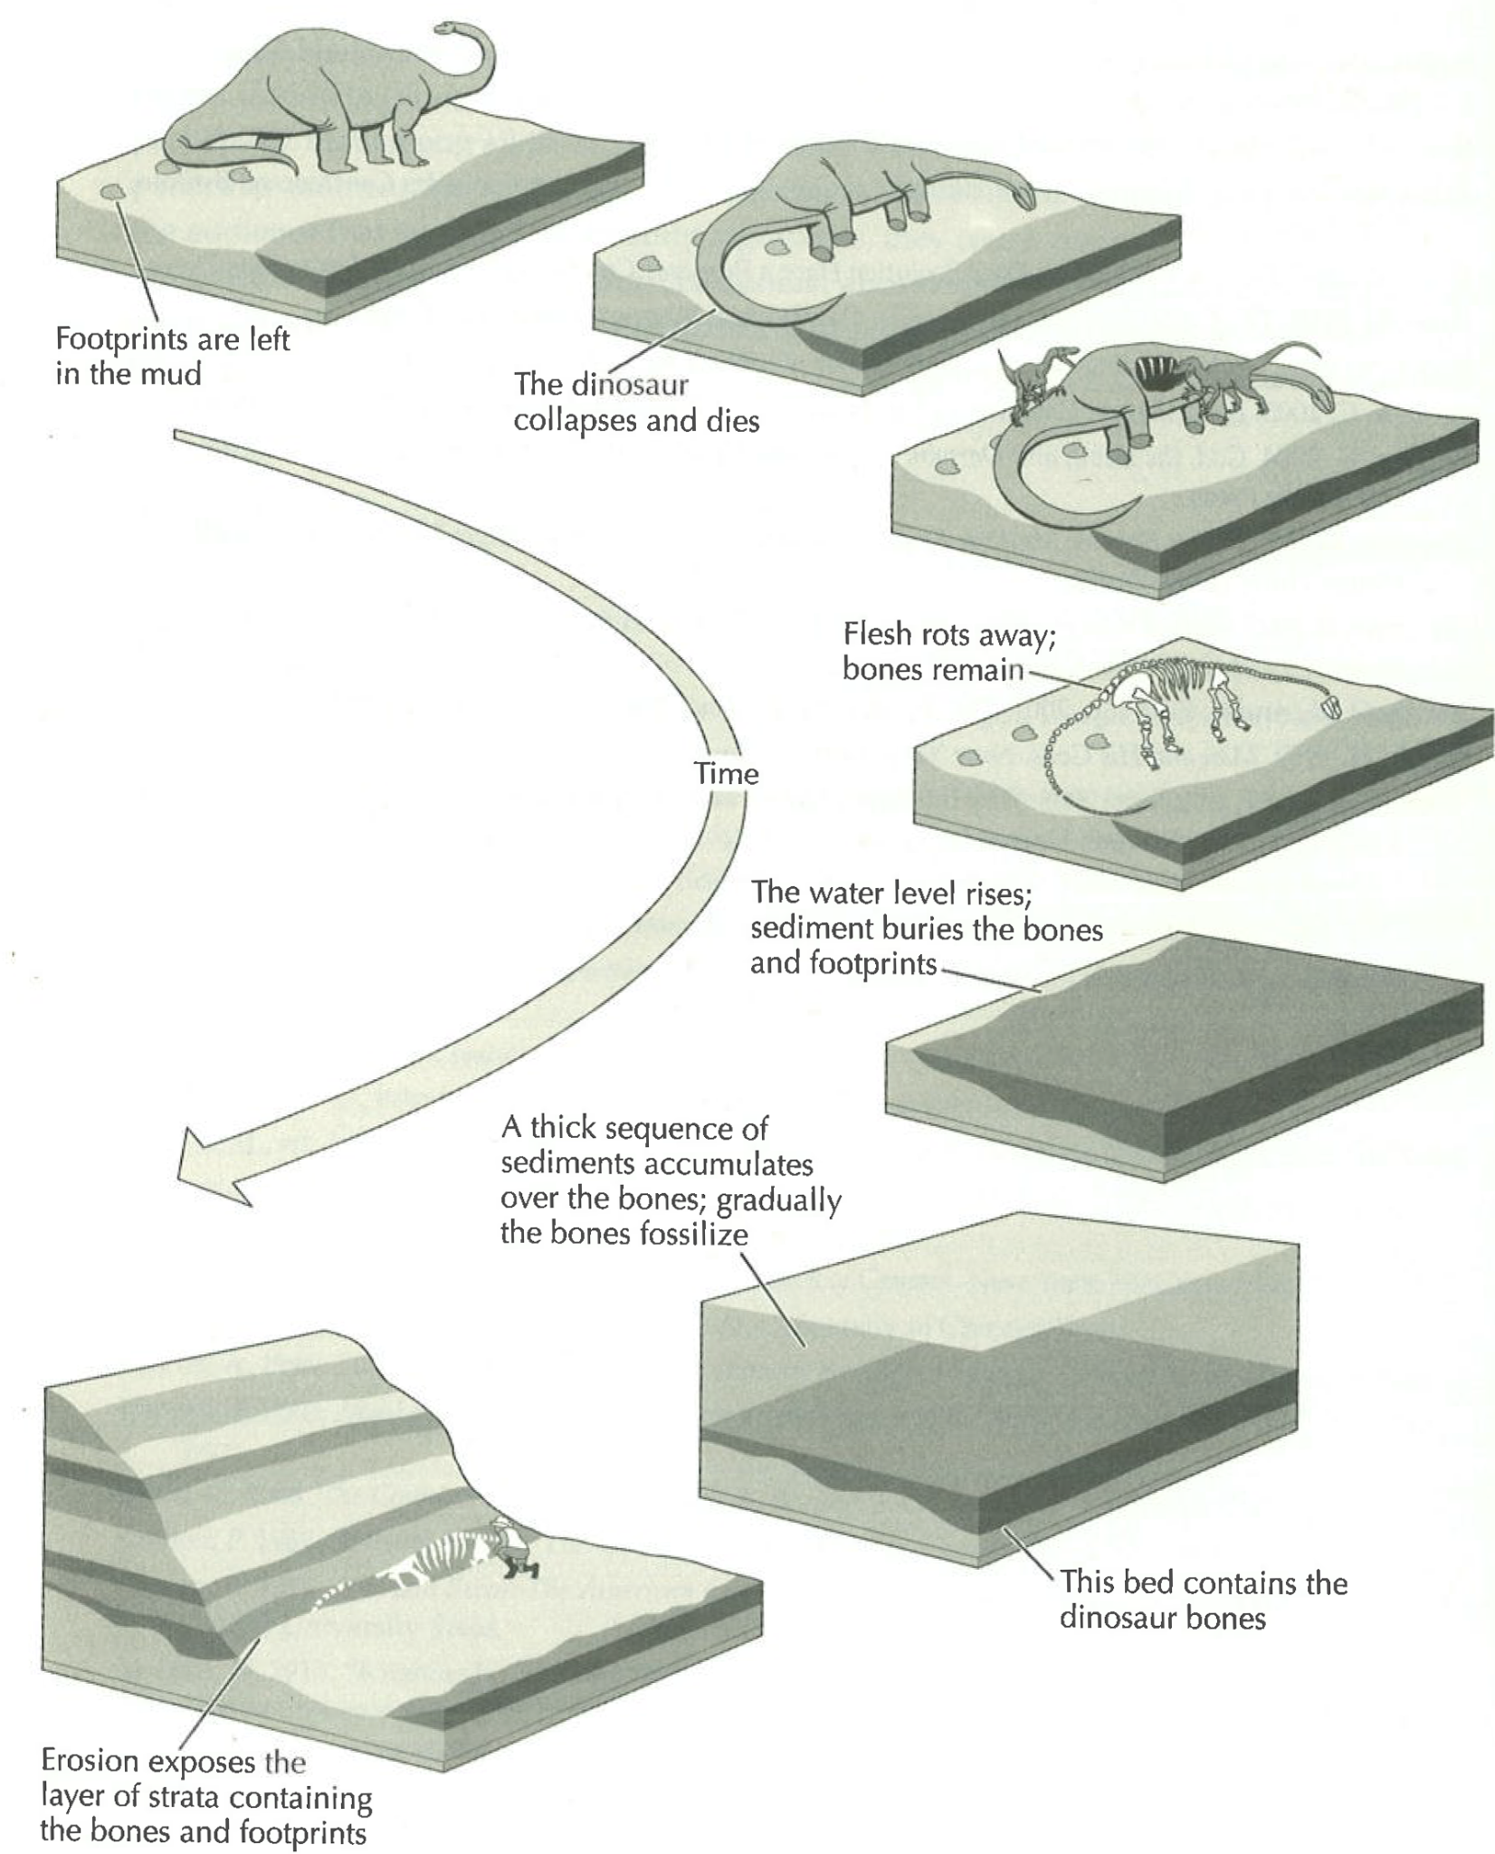
Fossilisation process
Notes:
https://www.youtube.com/watch?v=sEVnpEFoYOU

Slide 10
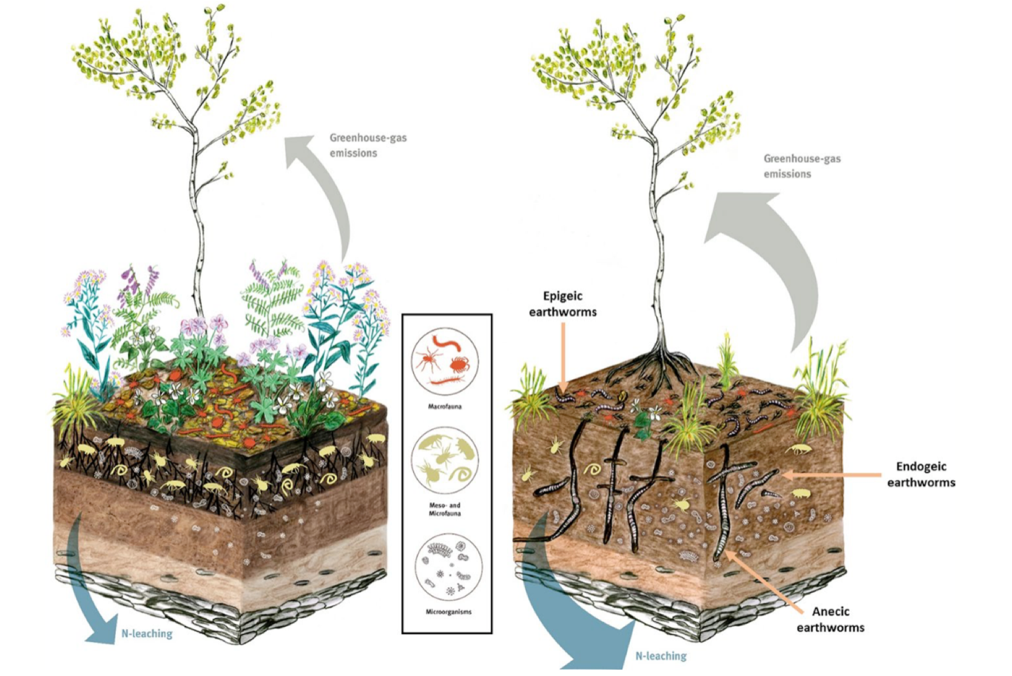
Bioturbation
Ferlian et al., 2017

Slide 11
Sequence stratigraphy

Slide 12
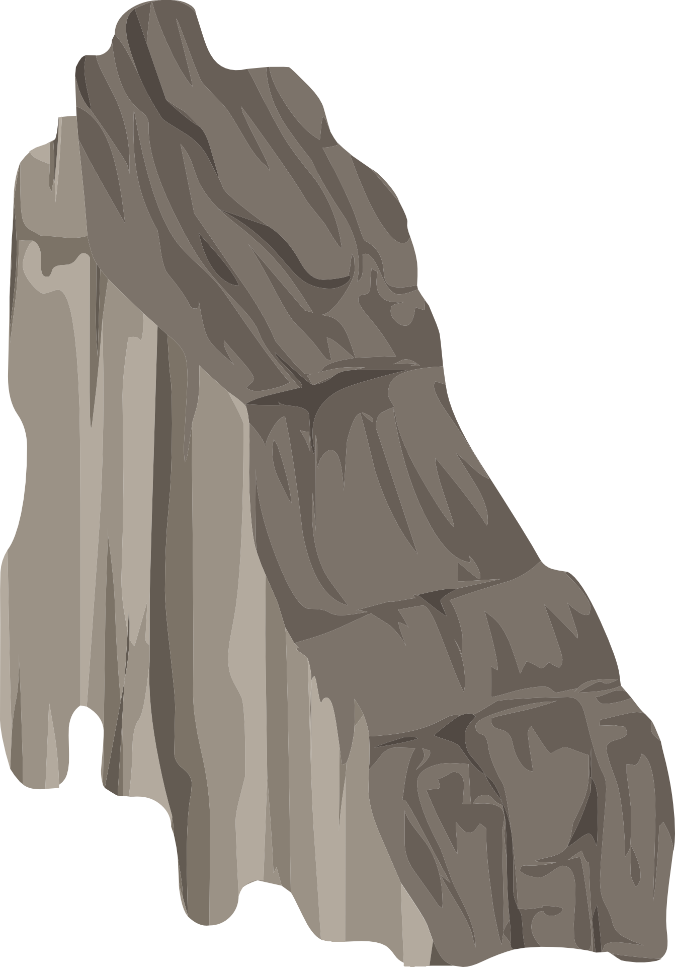
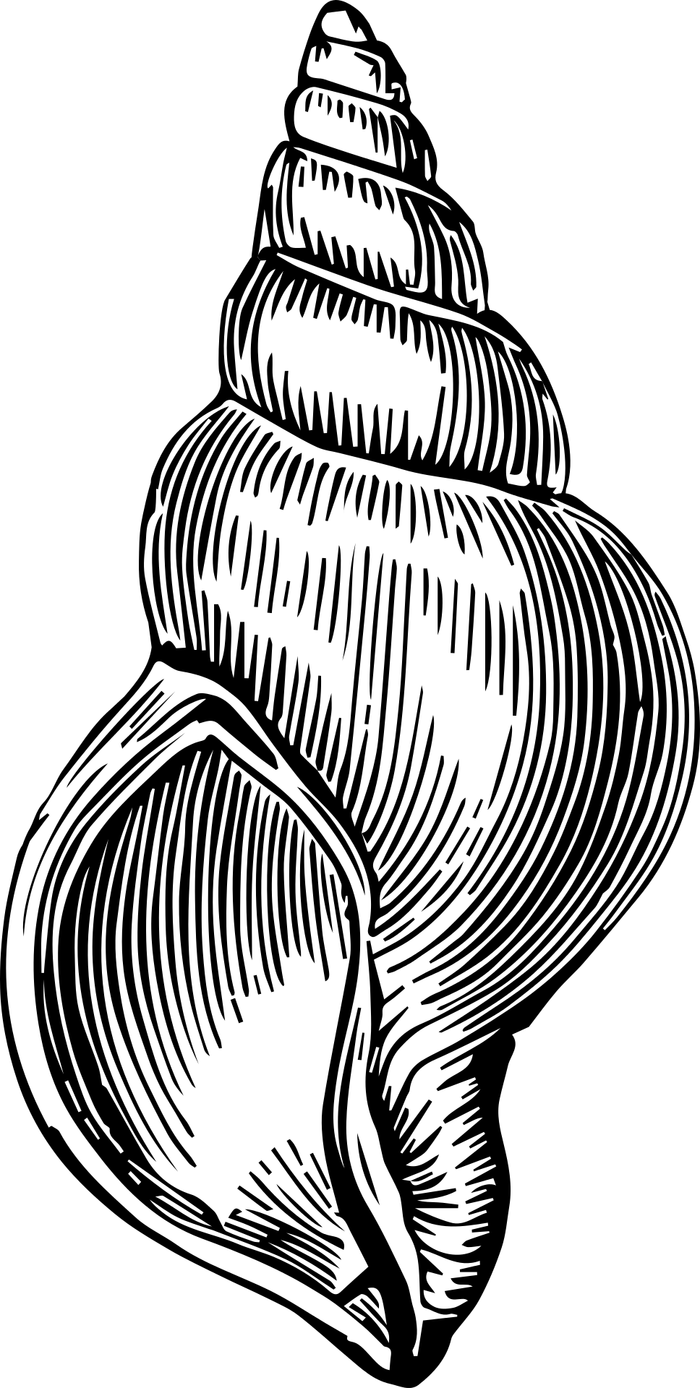
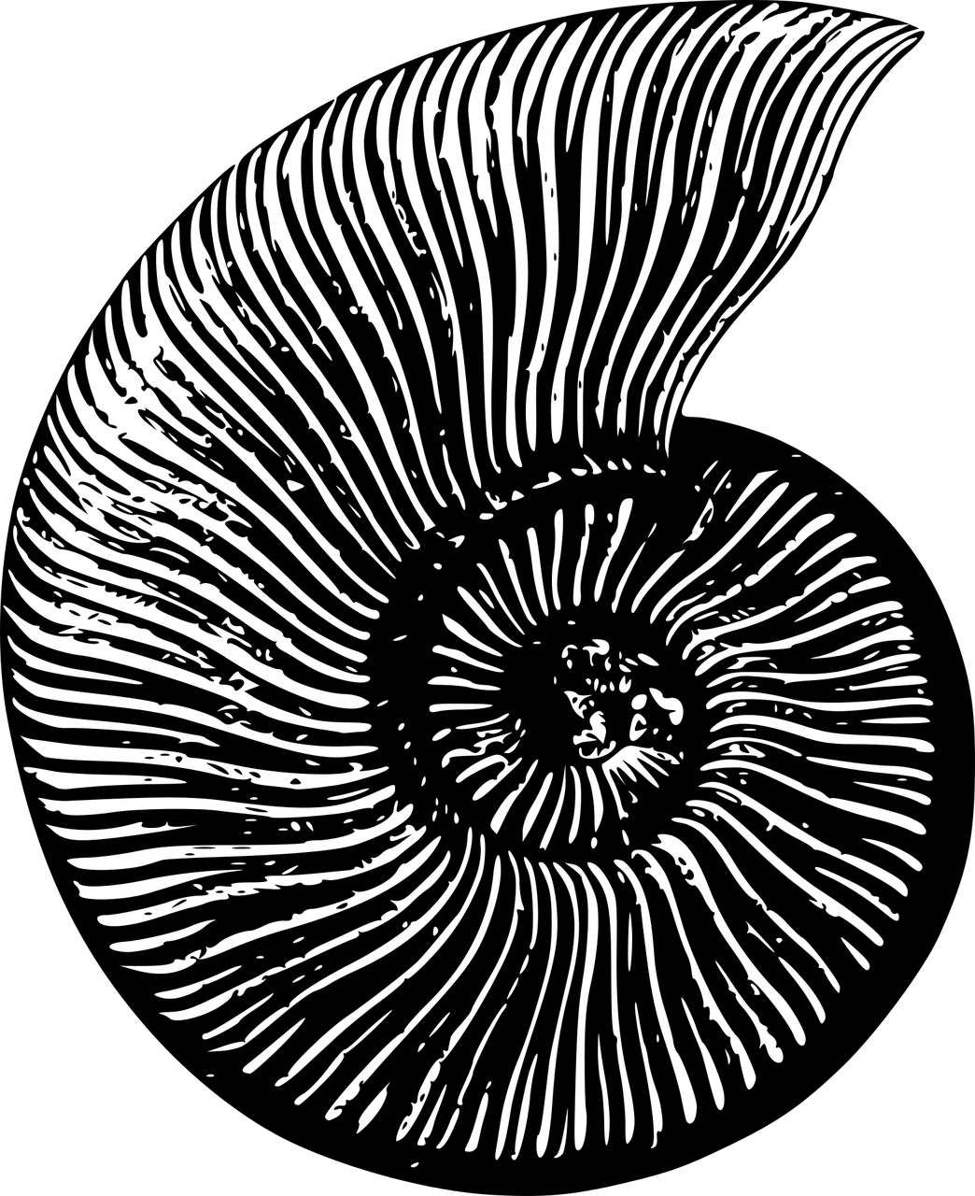
Fossil data
Age uncertainty

Slide 13
Exercise 7 – Temporal binning
Go through the 7_exercise_binning.R script in the Github repository sample_standardisation

Slide 14
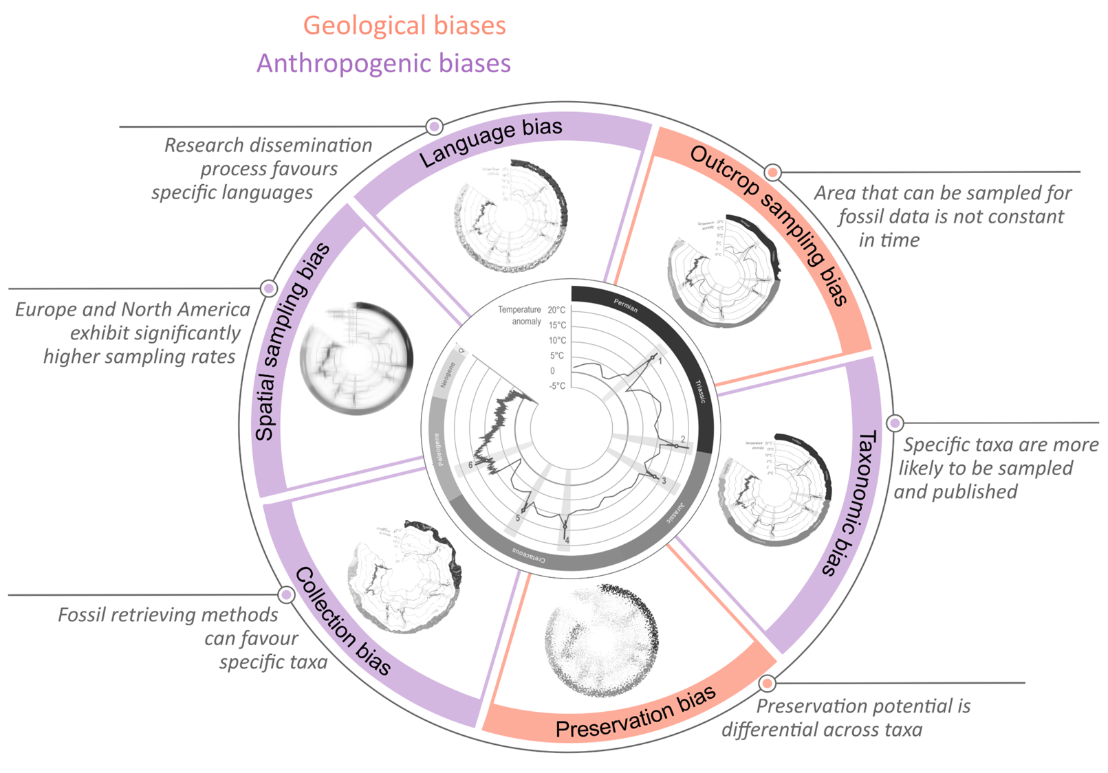
Paleontological biases

Slide 15
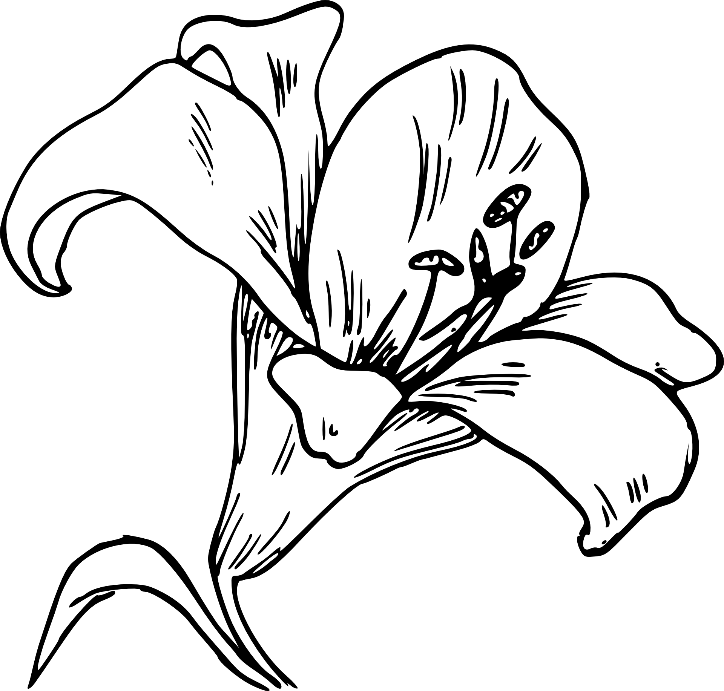
Palynological biases
Mind the gap

Slide 16
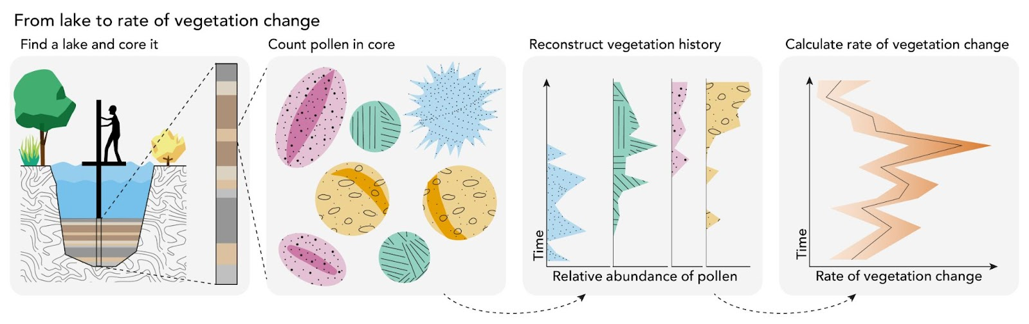
Palynology
Differential pollen productivity
Aerodynamic differences
Source area difference
Secondary transport
Differential decay
Taphonomic mixing
Identification bias
…
Artwork by Milan Teunissen van Manen

Slide 17
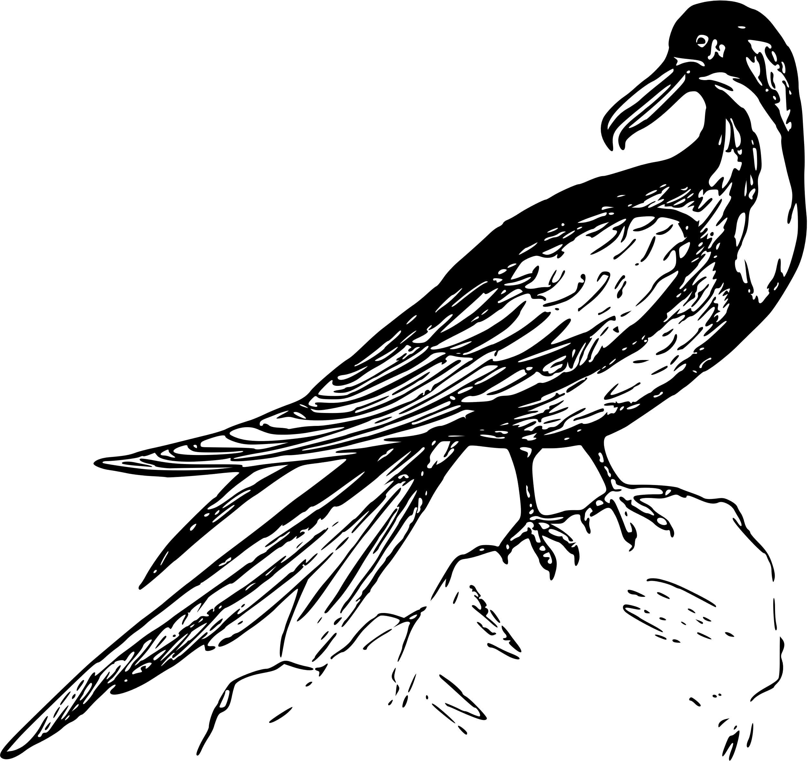
ecological biases
Mind the gap

Slide 18
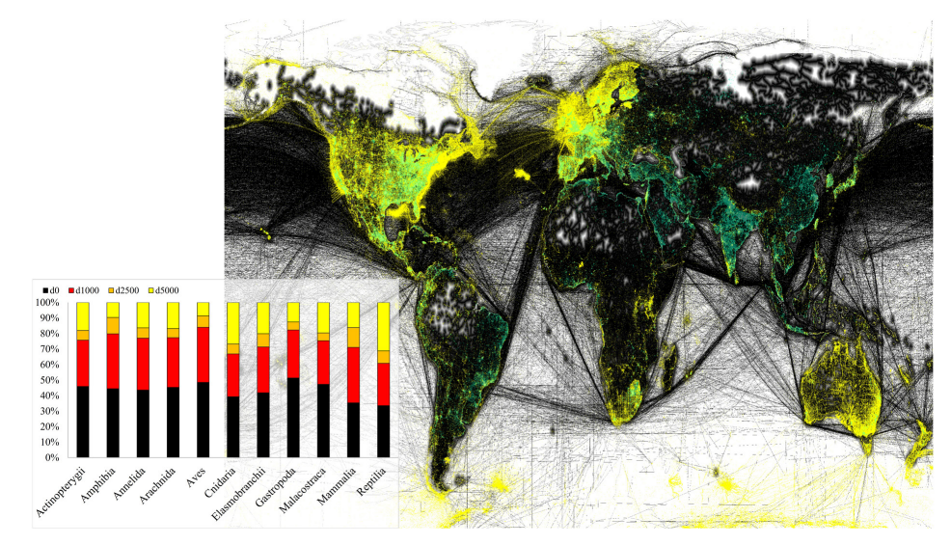
Ecological biases
Hughes et al., 2021
Notes:
Map of global OBIS and GBIF data for selected taxa (yellow) with roads and shipping routes (black) and cities (green). Species data fall almost exclusively on these access routes, (barplot) with most distribution data within 2.5 km of roads on land, or either on the coast or a shipping route on the ocean. Regional spatial biases are also clear.

Slide 19
Ecological biases
<10% of the globe sampled
Disproportionate tropical sampling
High elevations and deep seas are particularly unknown
Over 50% of records in most groups account for under 2% of species
Citizen-science exacerbates this bias
Hughes et al., 2021

Slide 20
How to resolve these biases?
Looking
one can get a better picture of irregularities and test underlying analytical assumptions by visualising the data
Talking
awareness of biases through interactions with people that have sampled/ created/ modified the data
Mimicking
simulating biases and the data generating process allows us to test methods against ground truth

Slide 21
How to resolve these biases?
Once we know about the data generating process, we can feed it into a Golem and let it make informed inferences

Slide 22
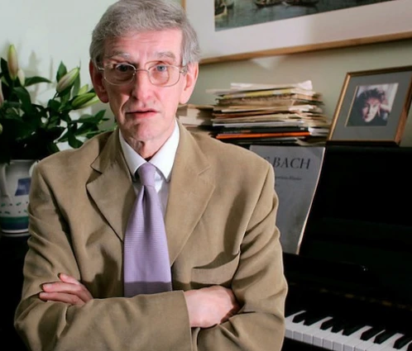
Mixed effect models
Golems with memory
Notes:
Anterograde amnesia
Clive Wearing was a talented musician and conductor
contracted Herpesviral Encephalitis
No longer able to create new memories

Slide 23
Mixed effect models
Common regression models have anterograde amnesia
no potential to apply information learned about one system to a new system
implicitly assume that nothing learned about any one category informs estimates for the other categories
we can refer to this type of models as “fixed effects” models
but we want models with memory to transfer information across systems

Slide 24
Mixed effect models
Fixed effect models rely on the assumption of independence
each observation is independent of others
real data often has multiple observations for individuals
real data often has hierarchical structures
ignoring these structure will result in inefficient estimates and possibly misleading inferences
we want models that are modeling both the within-individual (within-cluster) and between-individual (between-cluster) variation correctly

Slide 25
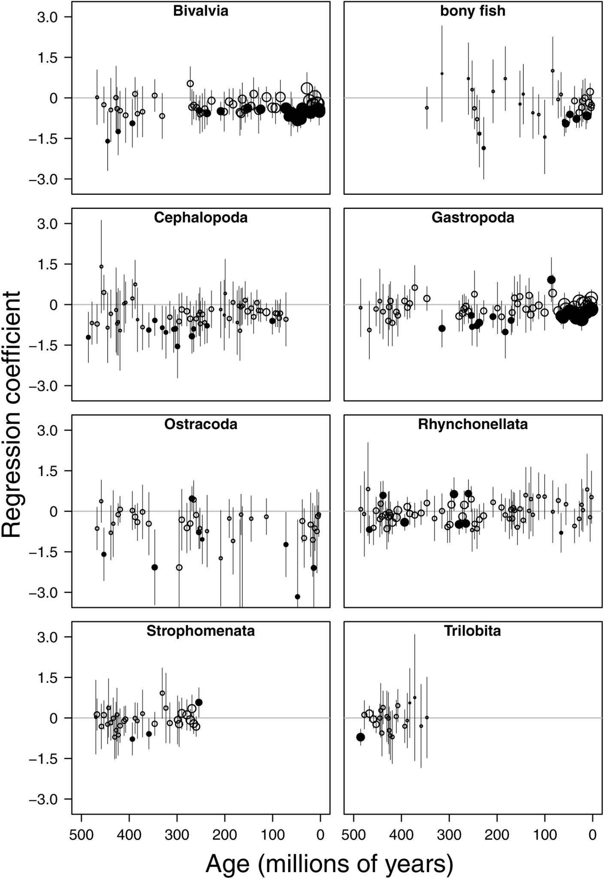
Ignoring time-variant information
Regression coefficient
Age (millions of years)
Payne, Jonathan L., and Noel A. Heim. "Body size, sampling completeness, and extinction risk in the marine fossil record." Paleobiology 46.1 (2020): 23-40.

Slide 26
Ignoring group-variant information
Payne, Jonathan L., and Noel A. Heim. "Body size, sampling completeness, and extinction risk in the marine fossil record." Paleobiology 46.1 (2020): 23-40.

Slide 27
Mixed effect models
mixed effect models can overcome these problems, providing more precise and more robust estimates
they have many synonyms
Hierarchical models, Multilevel models, Random coefficient models, Variance components models, Random effects models, Mixed models, Random intercept models, Random slope models

Slide 28
Mixed effect models in R
base R does not allow us to fit GLMMs or LMMs
There are many packages for this but lme4 for one is most often used
But Bayesian solutions (e.g., package brms) are much more flexible, powerful, and versatile
In lme4, the lmer function allows you to model normal outcomes and the glmer function to model non-normal outcomes
Similar to base R, you provide a formula, a dataset, and a family
But you also provide the mixed effects in brackets at the end of the formula

Slide 29
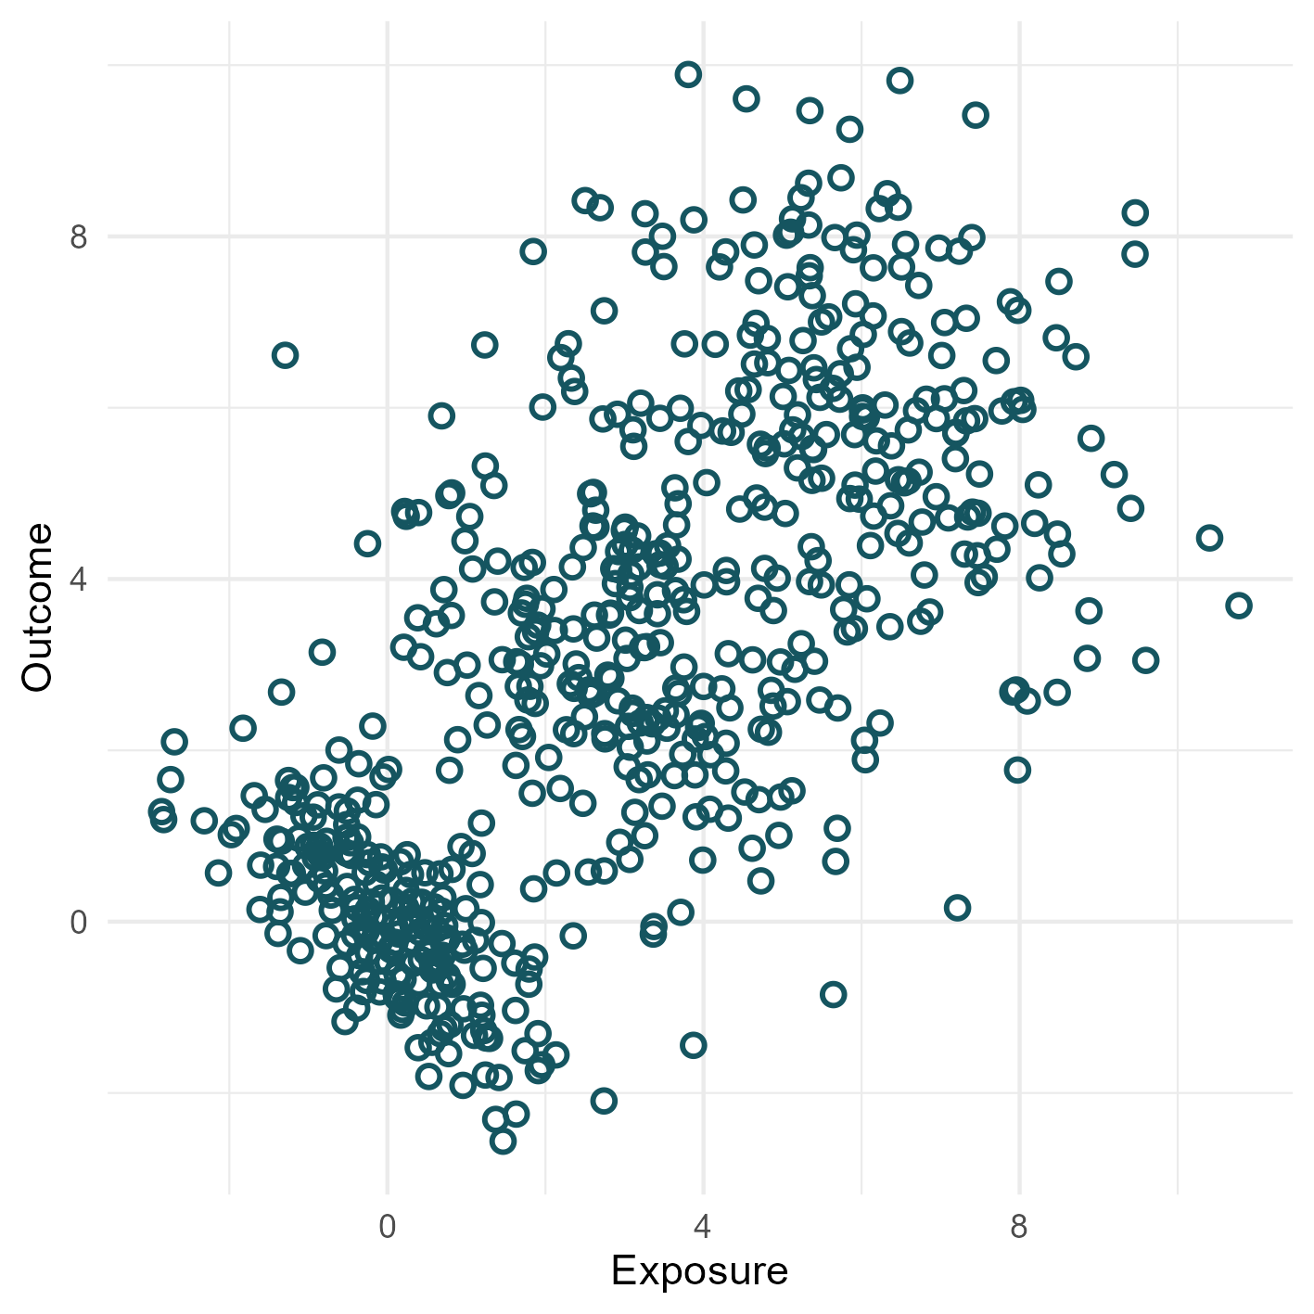
Random intercept
R code for this simulation, the following plots and the models can be found in the github repo under simulations/

Slide 30
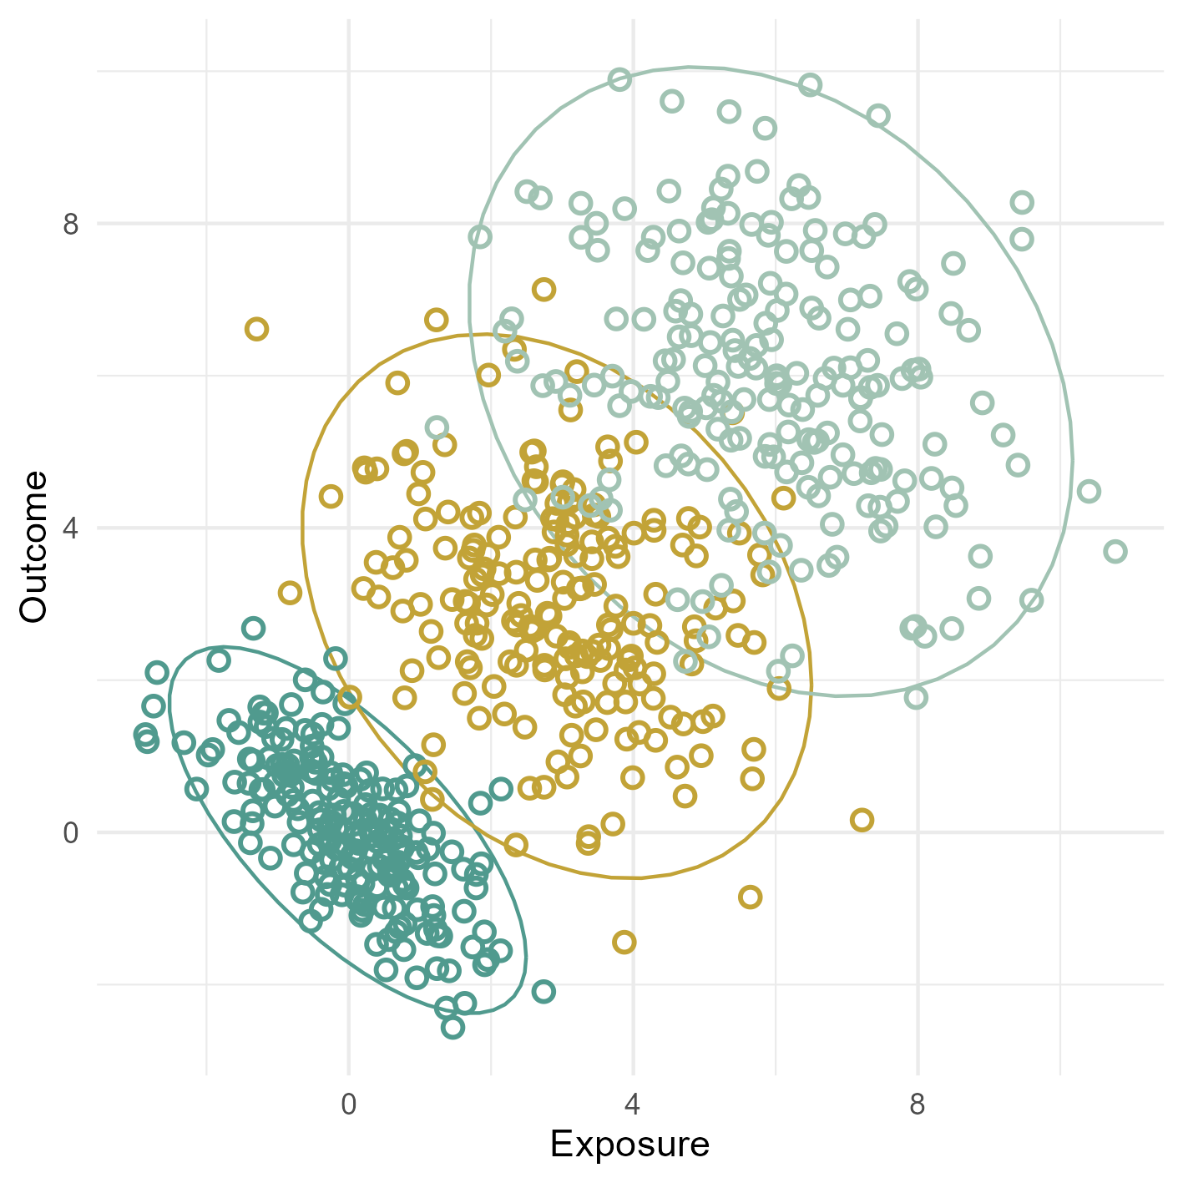
Random intercept
lm(Outcome ~ Exposure)
lmer(Outcome ~ Exposure + (1 | Group))

Slide 31
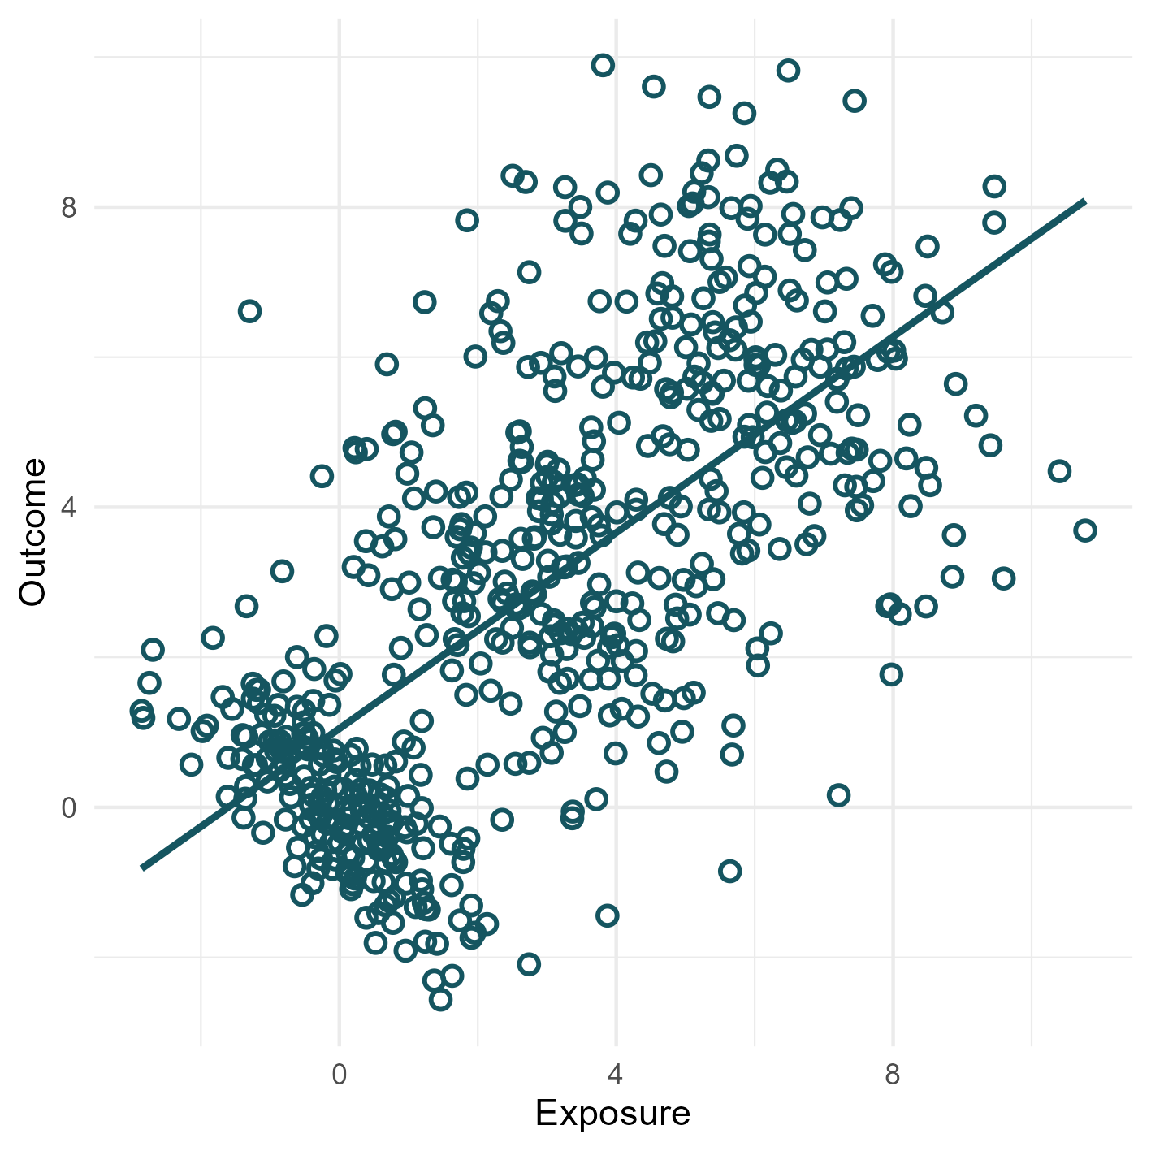
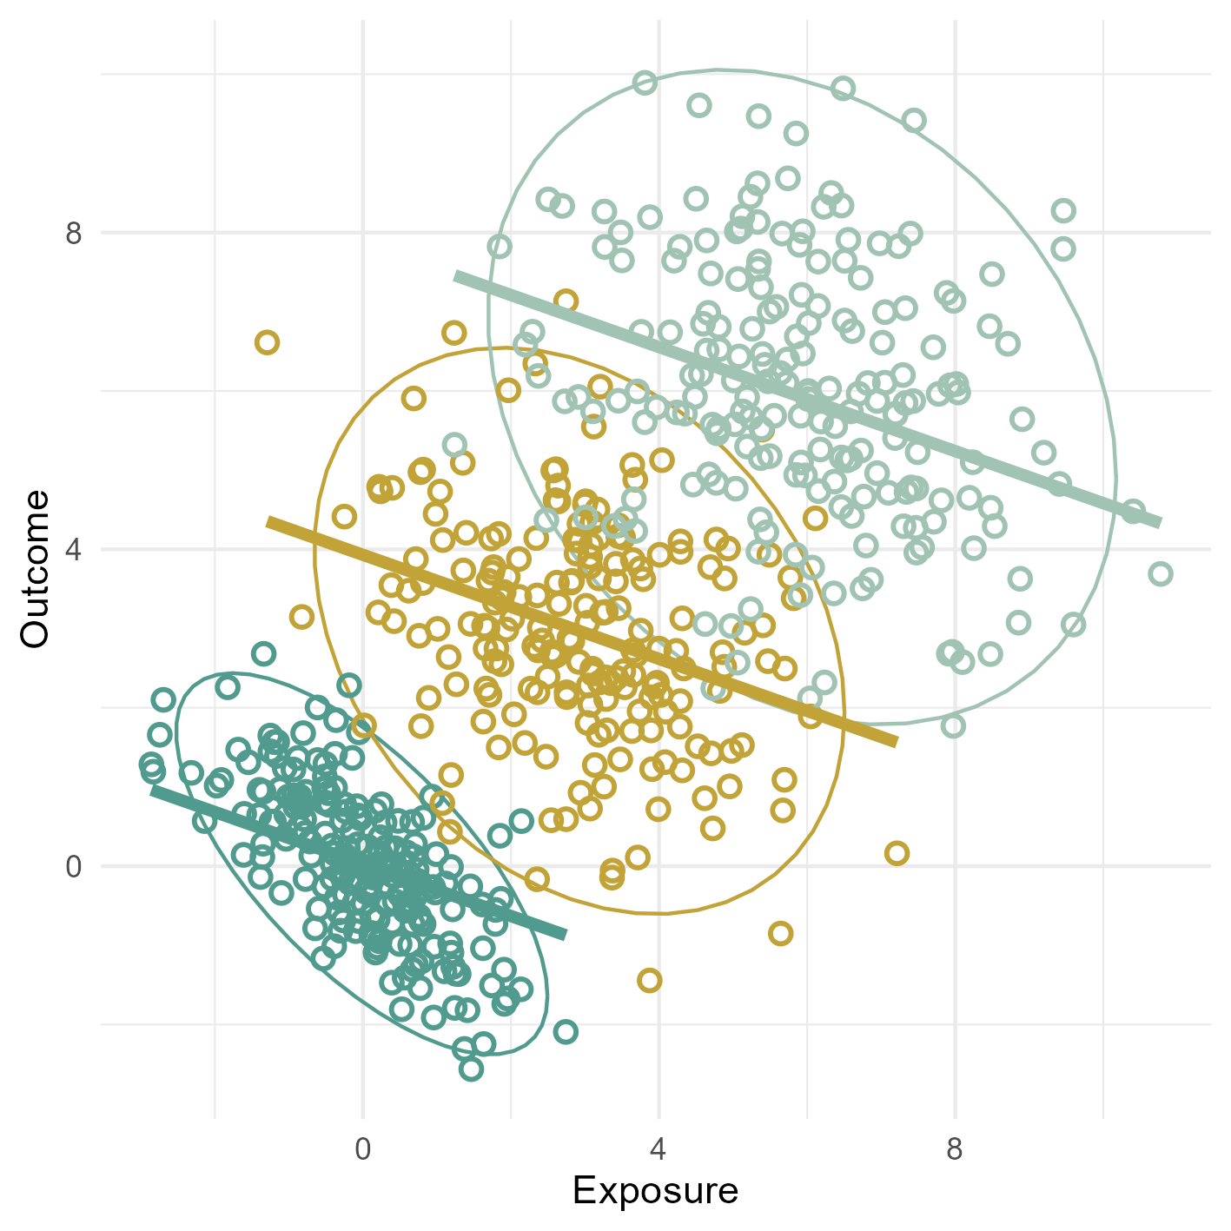
Random intercept
lm(Outcome ~ Exposure)
lmer(Outcome ~ Exposure + (1 | Group))

Slide 32
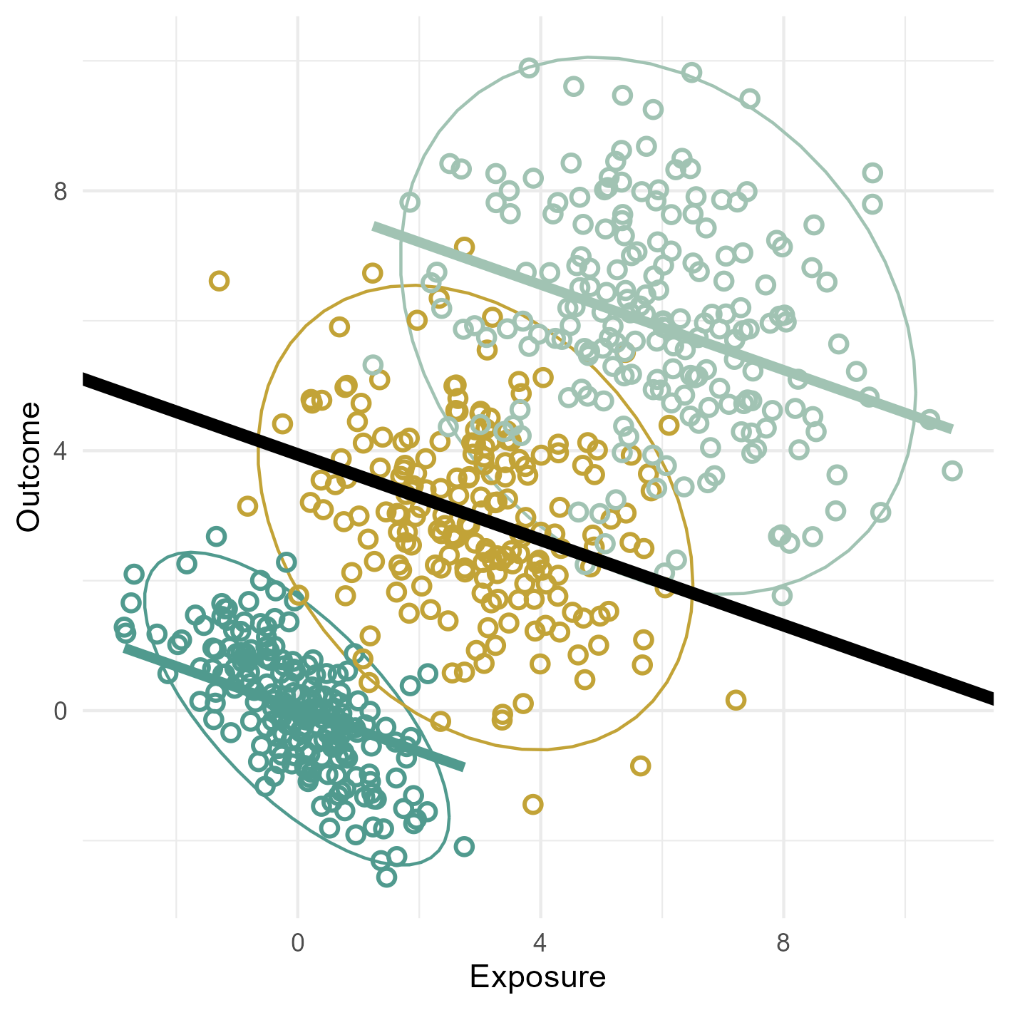
Random intercept
lm(Outcome ~ Exposure)
lmer(Outcome ~ Exposure + (1 | Group))

Slide 33
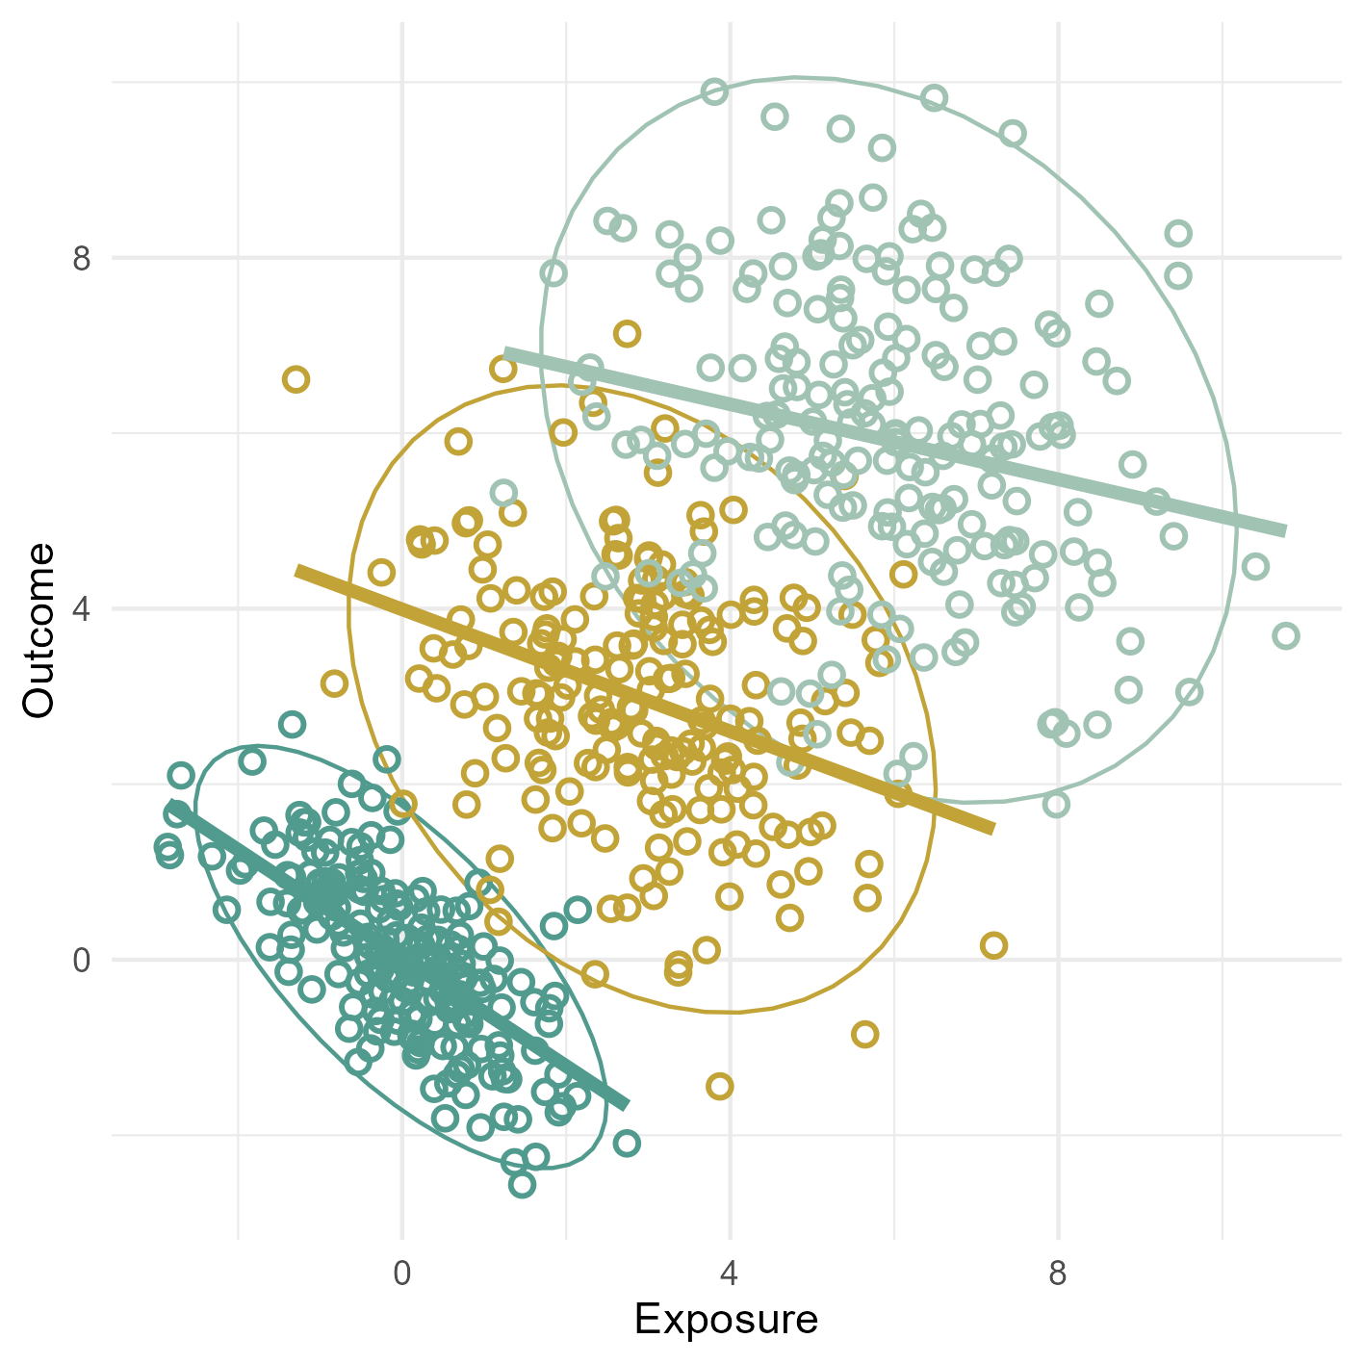
Random slope
lmer(Outcome ~ Exposure + (1 | Group))
lmer(Outcome ~ Exposure + (Exposure | Group))

Slide 34
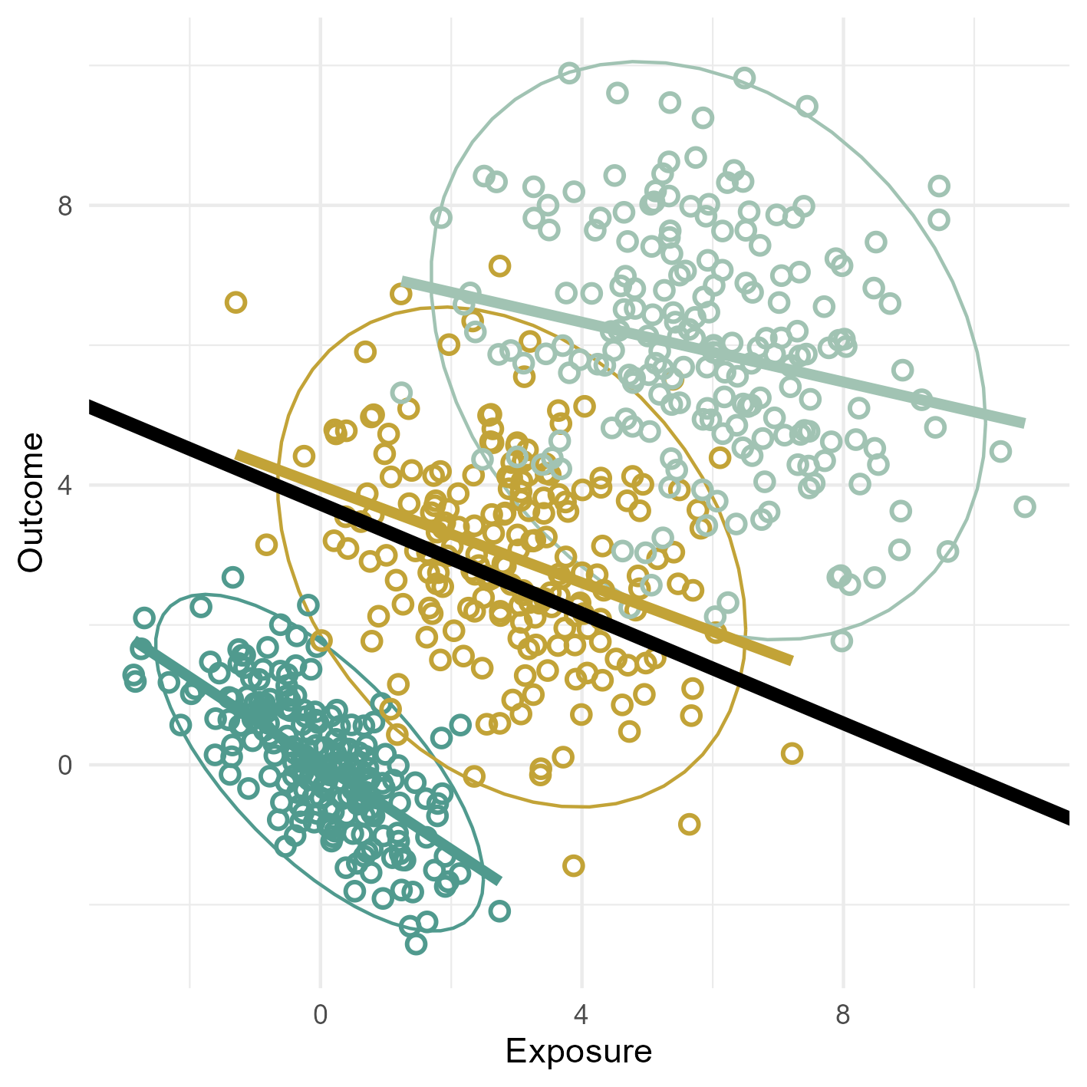
Random slope
lmer(Outcome ~ Exposure + (1 | Group))
lmer(Outcome ~ Exposure + (Exposure | Group))

Slide 35
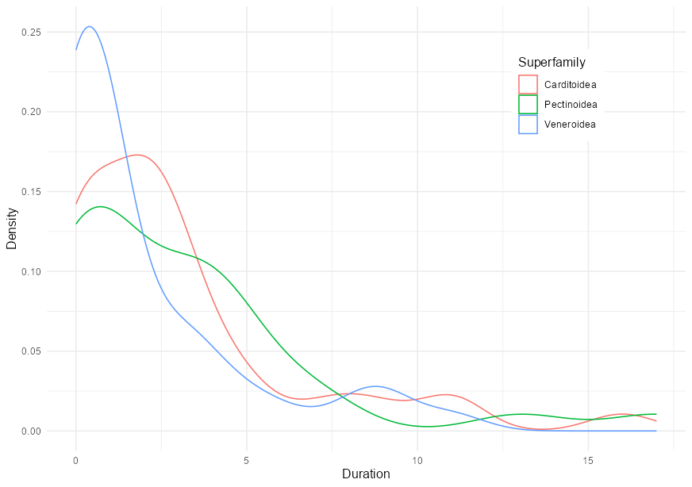
Cluster in the data

Slide 36
Exercise 8 – Models with memory
Go through the 8_exercise_glmm.R script in the Github repository sample_standardisation
Fossil dataset with species occurrences clustered into superfamilies
duration = how many stages a species survived
geo.range = geographic range, scaled between 0 and 1

Slide 37
Extreme 1

Slide 38
Extreme 1
quite little data goes into each model and contributes to each estimate
resulting estimates are rather imprecise and have low statistical power
as a consequence, the error of these estimates is high, and they are rather overfit to the data
standard errors for each intercept can be very large, and in extreme cases, even infinite
this is often called the no pooling approach

Slide 39
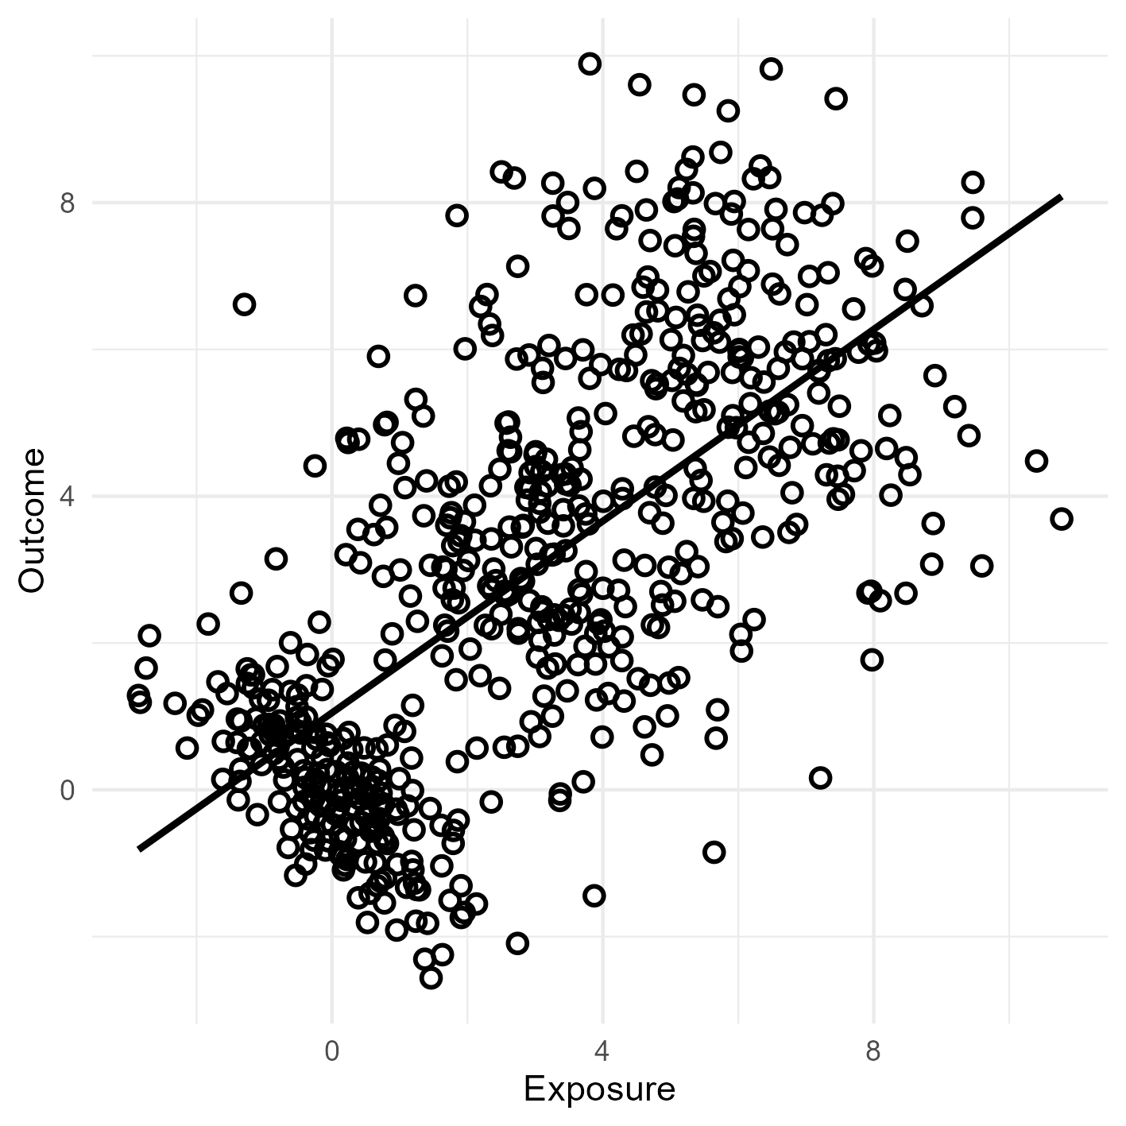
Extreme 2

Slide 40
Extreme 2
a lot of data contributes to estimates of α, and so it can be quite precise
however, the estimate of α is unlikely to exactly match the mean of any particular stage or taxon group
as a result, the total sample mean or slope underfits the data
this is the complete pooling approach, pooling the data from all stages and taxon groups to produce a single estimate that is applied to every stage and taxon group
this sort of model is equivalent to assuming that the variation among stages or taxa is zero—all stages or all taxa are identical

Slide 41
Over- and underfitting
mixed effect models use partial pooling of information to produce estimates for each group that are less underfit than the grand mean/ slope and less overfit than the no-pooling estimates
as a consequence, they tend to be better estimates of the true per-group means/ slopes
this is especially true when groups have few observations in them, because then the no pooling estimates will be especially overfit
when a lot of data goes into each group, then there will be less difference between the mixed effects estimates and the no pooling estimates
this phenomenon is called shrinkage
mixed effect models can therefore be considered as sampling size corrective

Slide 42
Simulation
in each stage, species can either go extinct or survive
the number of species (observations) in each stage varies, with some stages having a lot and some only a few
we then calculate the mean survival probability per stage without mixed effects (no pooling)
we then compare this estimate to a mixed effect model (partial pooling) and see which one are closer to the truth
we know the truth as we simulated it

Slide 43
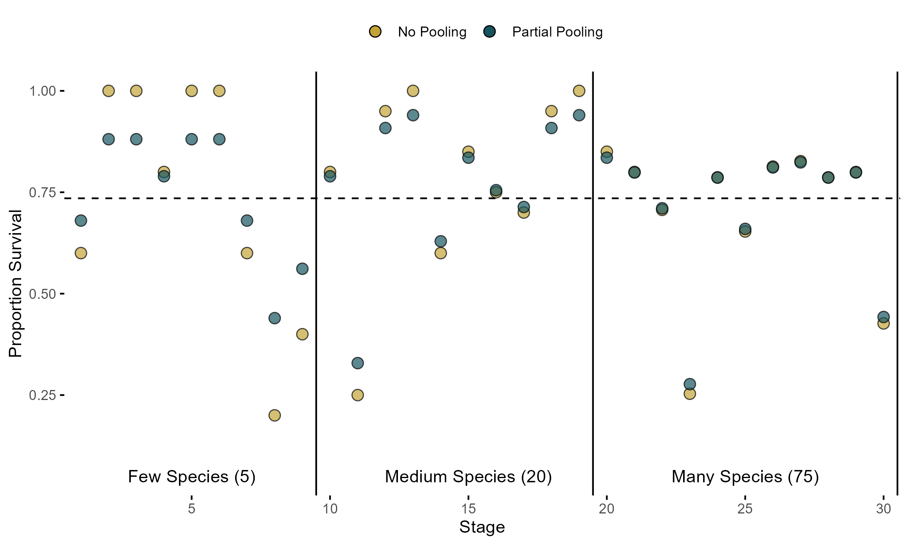
Simulation

Slide 44
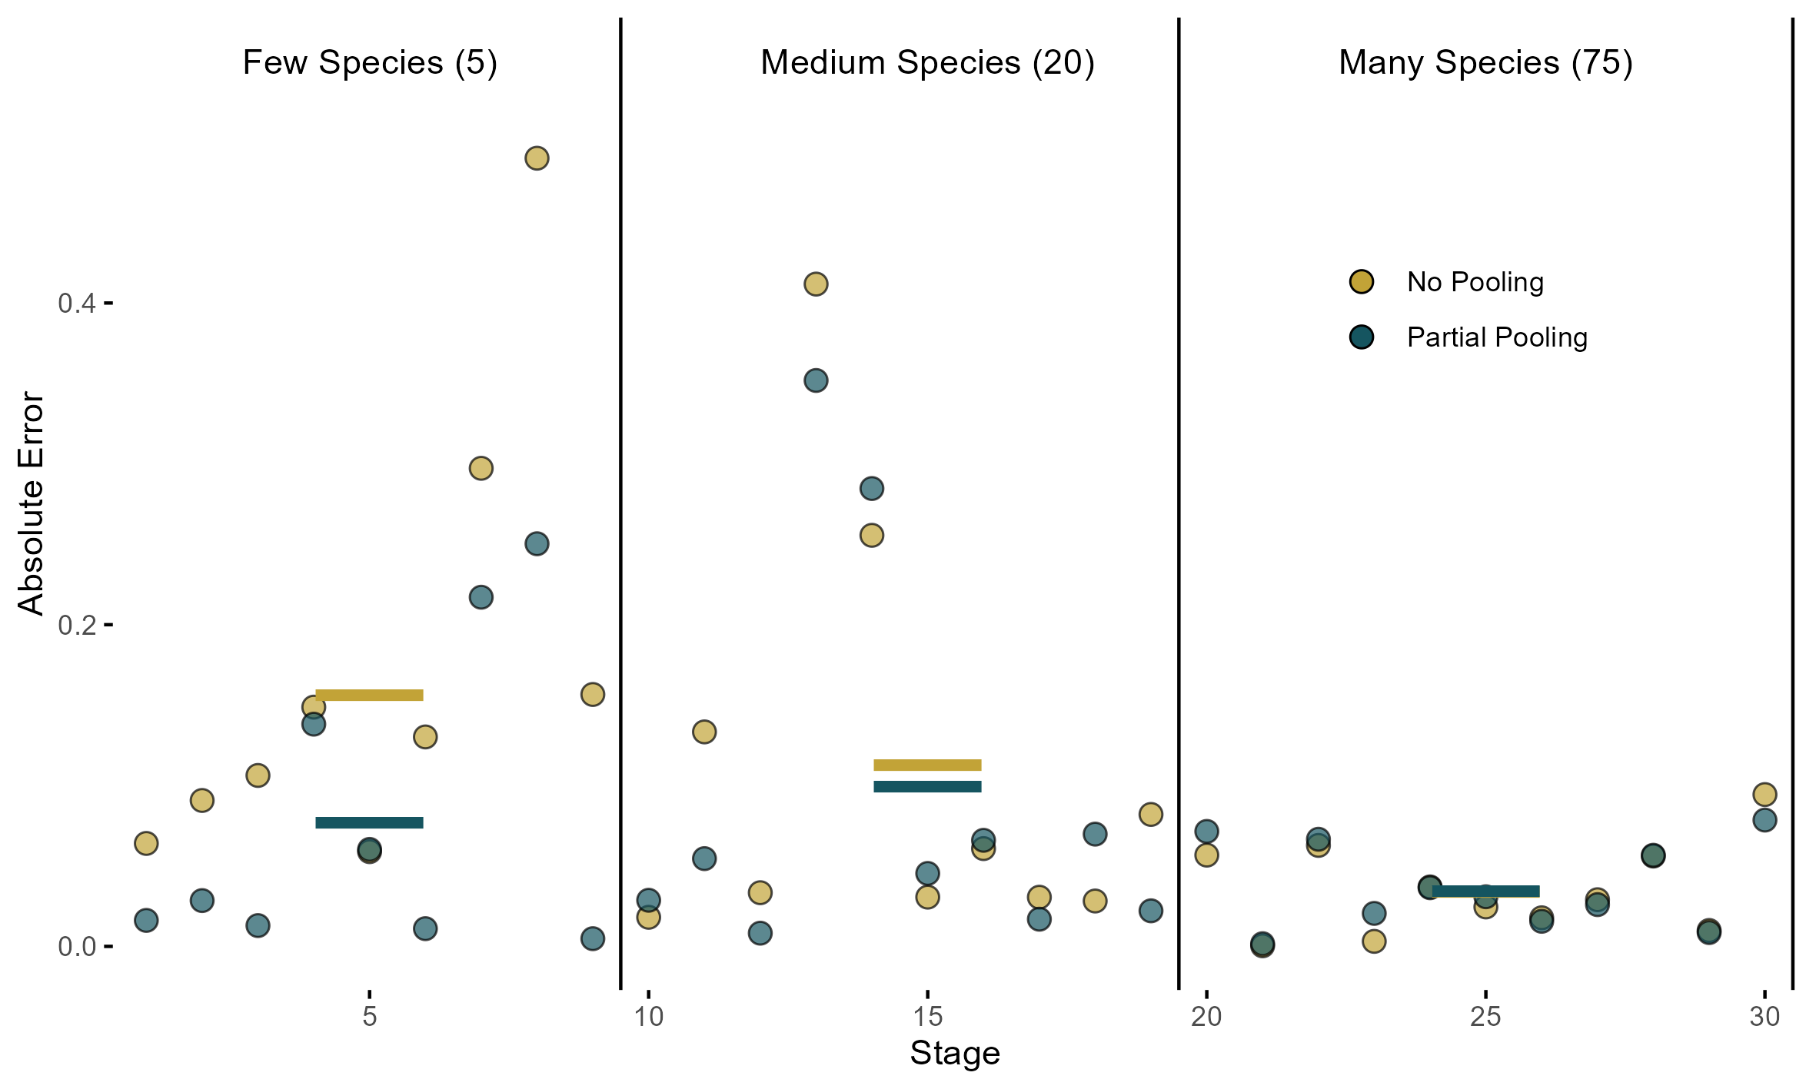
Simulation

Slide 45
Recap
Complete pooling: This means we assume that the population of stages is invariant, the same as estimating a common intercept (extinction risk) for all stages
No pooling: This means we assume that each stage tells us nothing about any other stage. This is the model with amnesia
Partial pooling: Using shrinkage to avoid over- and underfitting

Slide 46
Summary
Real world data is heavily biased
Mixed effect models are a way to tell Golems about these biases, and to resolve them
can be used to address measurement error, missing data, spatial correlation …
This is done by pooling information across inherent clusters/ groups (the “random effects”)
Advantages:
Improved estimates for repeat sampling
Improved estimates for imbalance in sampling
Improved estimates of variation

Slide 47
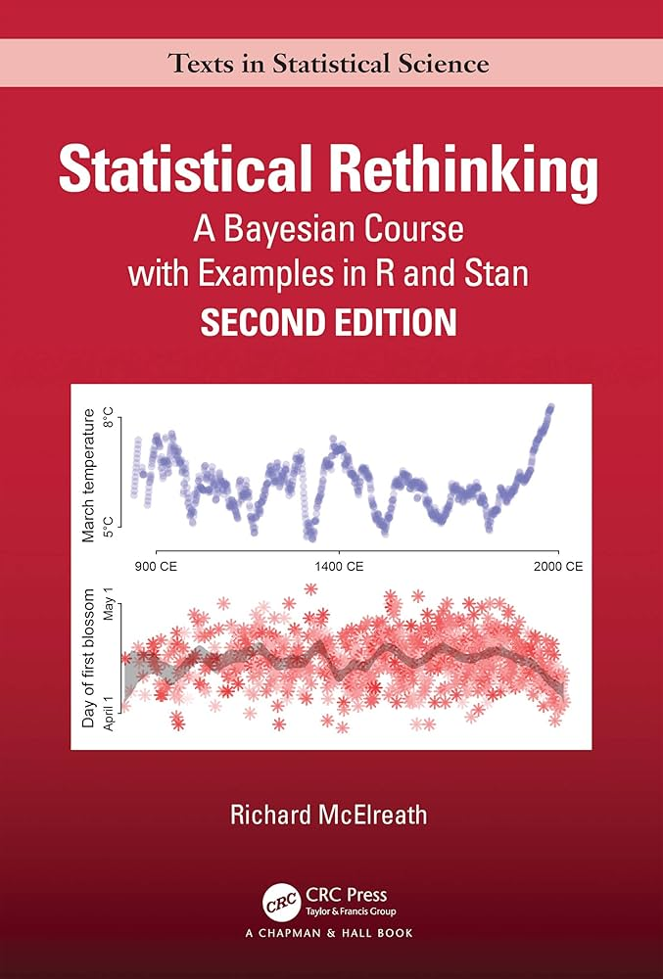


Main references
Generative models
Richard McElreath: Statistical Rethinking
Causal inference
Judea Pearl: The book of why
Epistemiology
Michael Strevens: The knowledge machine
Notes:
Karl Popper (Falsifying), Thomas Kuhn (Paradigm Shifts)

Slide 48


